Slide 1

PROBLEM STATEMENT
Many Children grow with limited awareness & discipline about environmental sustainability.So our webgame helps to reduce critical gap between children & environment education.
In our society,Due to Children's gaming addiction ,it affects their health & studies. Our app empowers children to learn through gamified experiences, fostering a passion for sustainable development..

Slide 2


MAIN GOALS
To establish discipline & make ecofriendly behaviour on children.
To make long lasting impact on child’s environmental awareness.

Slide 3

NAMASTE !
WE ARE FROM TEAM NEXUS
Prashnta Pandey
Sujan Ghimire
Prabin K. Chalaune
Dinesh Nepal

Slide 4

PROJECT FEATURES
It include quiz quest features. So ,user can be entertained & learn with Gaming joy and fun.
Rewards & scoring features based on performance.
User authentication features.
Storing of User Score in real time database.
Simple & Child friendly interactive UI.

Slide 5
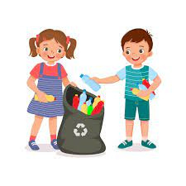
ENVIRONMENTAL IMPACTS
It empowers in shaping a younger generation towards sustainable development as child are the pillar of the country‘s development.
Encourages child for waste management, tree plantation which helps to balance ecosystem.

Slide 6


PROJECT DEMO

Slide 7
BUSINESS MODEL
We can generate revenue through educational partnership program with different organization like NGOS, INGOS etc.
We can launch this game in different platforms like Playstore, Apple store, Game jolt etc.
We can offer premium features for exclusive challenges and quests, allowing users to unlock a distinctive learning experience.

Slide 8
THANK YOU
Any Quesries...?
/ Suggestion

